Slide 1
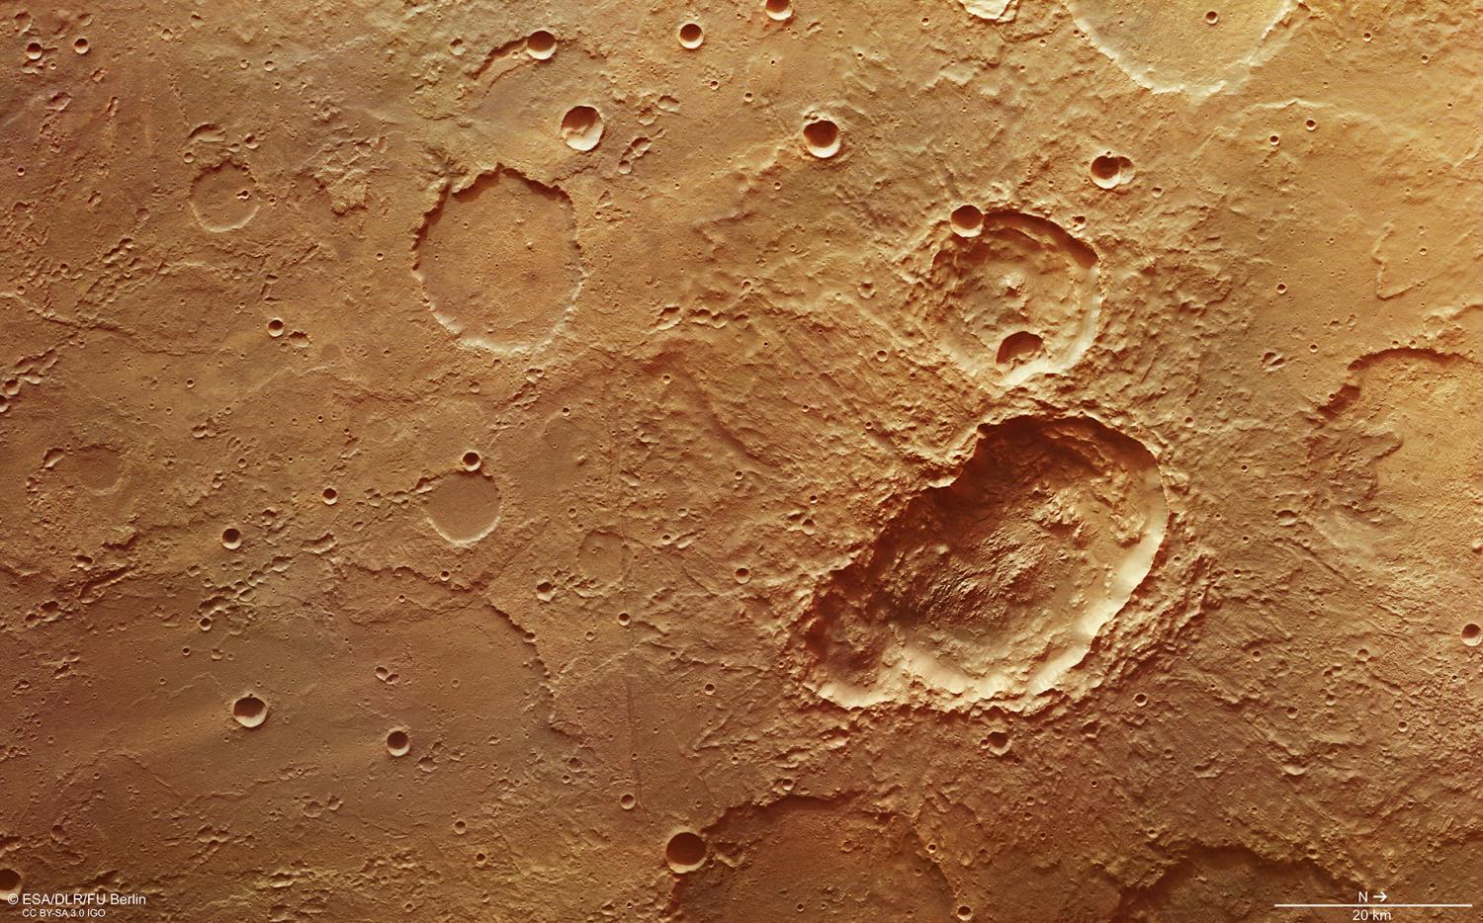
OpenCV-based Craters Detection on Mars
Sławomir Figiel Tomasz Mrugalski Ewelina Omernik

Slide 2
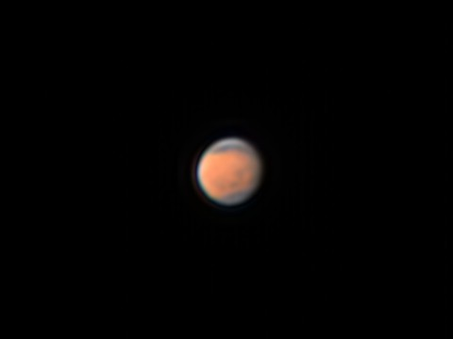
Mars opposition, 2016

Slide 3
Why Mars has so many craters?
The most similar planet to Earth in our Solar System
Proximity of main asteroid belt
Reasonable proximity of the largest perturber in the Solar system
Well studied (= a lot of photos)

Slide 4
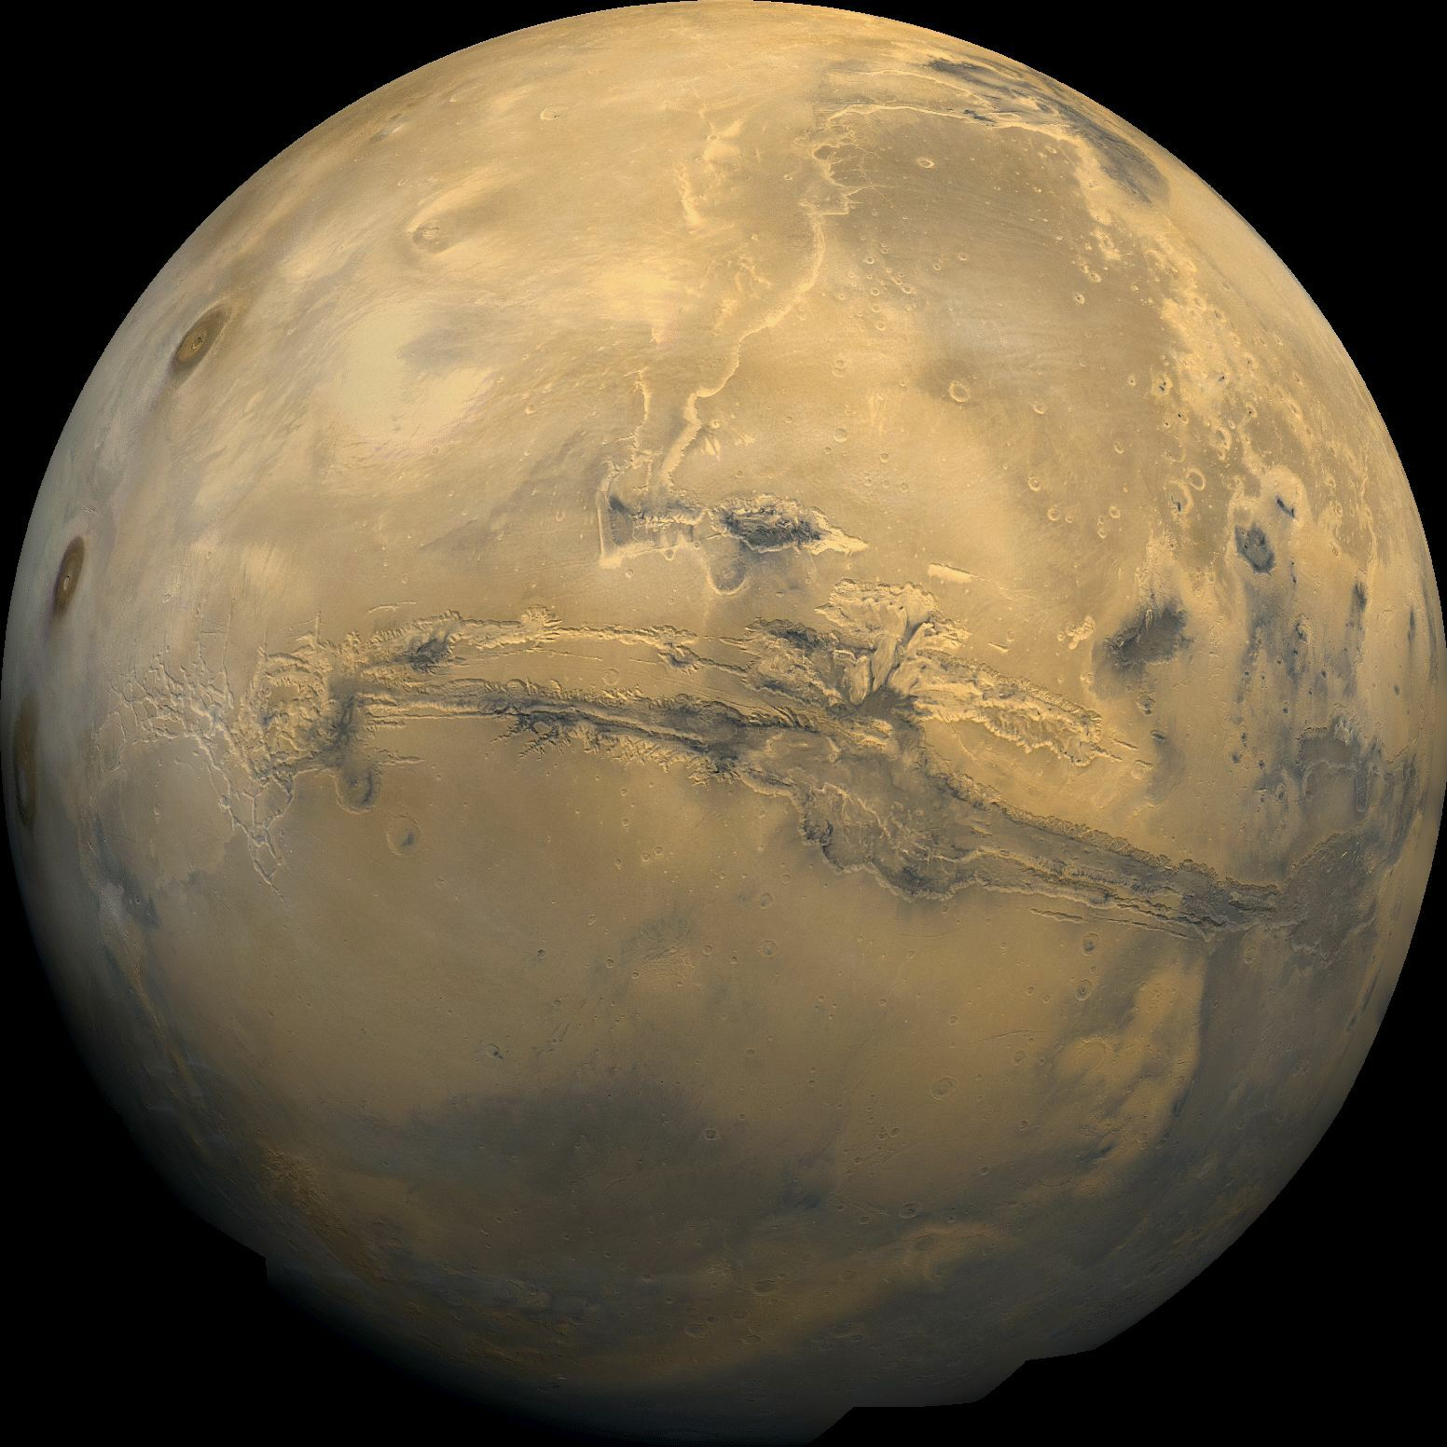
Choosing best area
Most asteroids near the ecliptic plane
Mars inclination is 23 deg

Slide 5
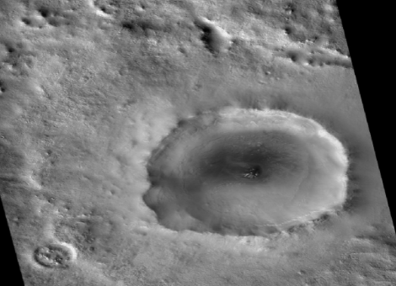
Initial data selection
very bright craters’ edges on images

Slide 6
Initial data selection
Problems:
Not every crater has a bright edge
Depth must be at least 0.4-0.5 km
Radius must be lower than 15km
Craters are not the only objects that have a bright edges

Slide 7

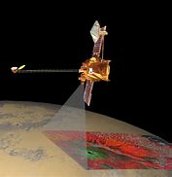
Early experiments - GIMP
GIMP Software
Images from THEMIS instrument

Slide 8
Early experiments - GIMP
First method:
subtle Gauss blur
thresholding (with pixels within range 160-170 treated as white)
dilate filter that widened and enlarged the detected areas

Slide 9
Early experiments - GIMP
Second method:
aggressive Gaussian blur,
thresholding at the value 160,
detecting edges using Gaussian differences,
second thresholding

Slide 10
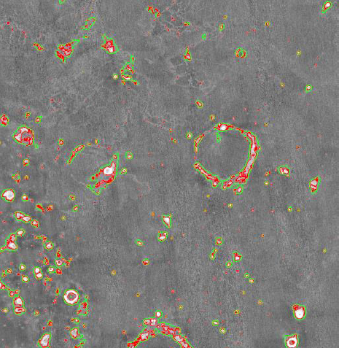
Early experiments - GIMP

Slide 11
Early experiments - GIMP
Conclusions:
Initial blur is necessary to remove minor noise,
The blur parameters must be adjusted to the size of the craters being searched

Slide 12


Pattern recognition using OpenCV
OpenCV library,
Python programming language,
Circle Hough transform (CHT) algorithm with Hough Gradient detection method

Slide 13
Pattern recognition using OpenCV
First experiment:
Converted to grayscale,
Median blur:
Radius 12,
Percentile 66,
High precision
Edge detection mechanism:
Gradient,
Amount 1
Sobel edge detection algorithm

Slide 14
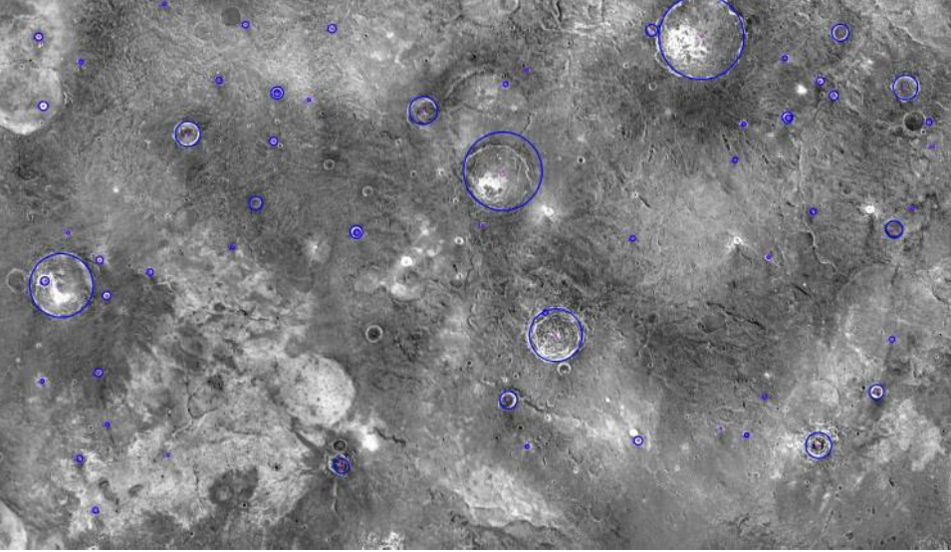
Pattern recognition using OpenCV

Slide 15
Pattern recognition using OpenCV
Second experiment:
the same approach as before,
Looking for two types of circles:
distance 150px, min rad 10px, max rad 50px,
distance 550px, min rad 50px, max rad 500px

Slide 16
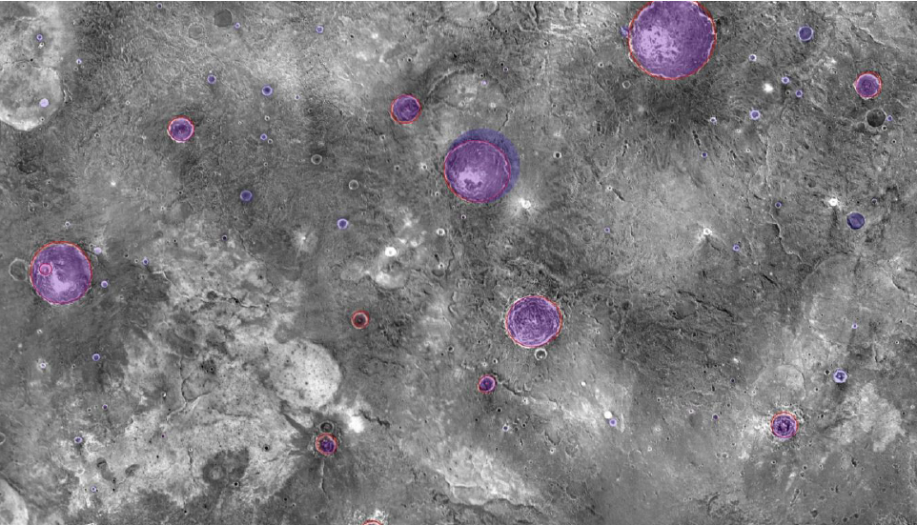
Pattern recognition using OpenCV

Slide 17
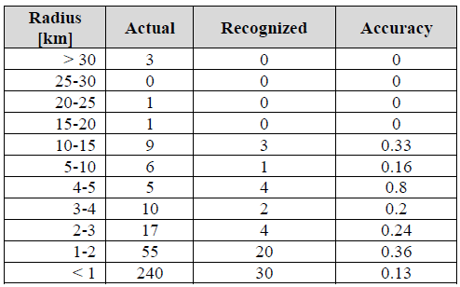
Algorithm Performance
Comparison between detected craters and information provided by JMars project (second OpenCV experiment)

Slide 18
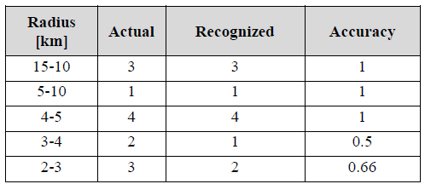
Algorithm Performance
Parametrized evaluation for radius < 15 km and depth > 0.5 km:

Slide 19
Conclusions
There were no false positives – every detection was an actual crater,
Assuming the parameters of radius less than 15km and crater depth at least 500m, the algorithm achieved a very good accuracy of 85%.

Slide 20
Next steps
Compare with Machine learning
Improve robustness of the code
Make the solution user friendly

Slide 21
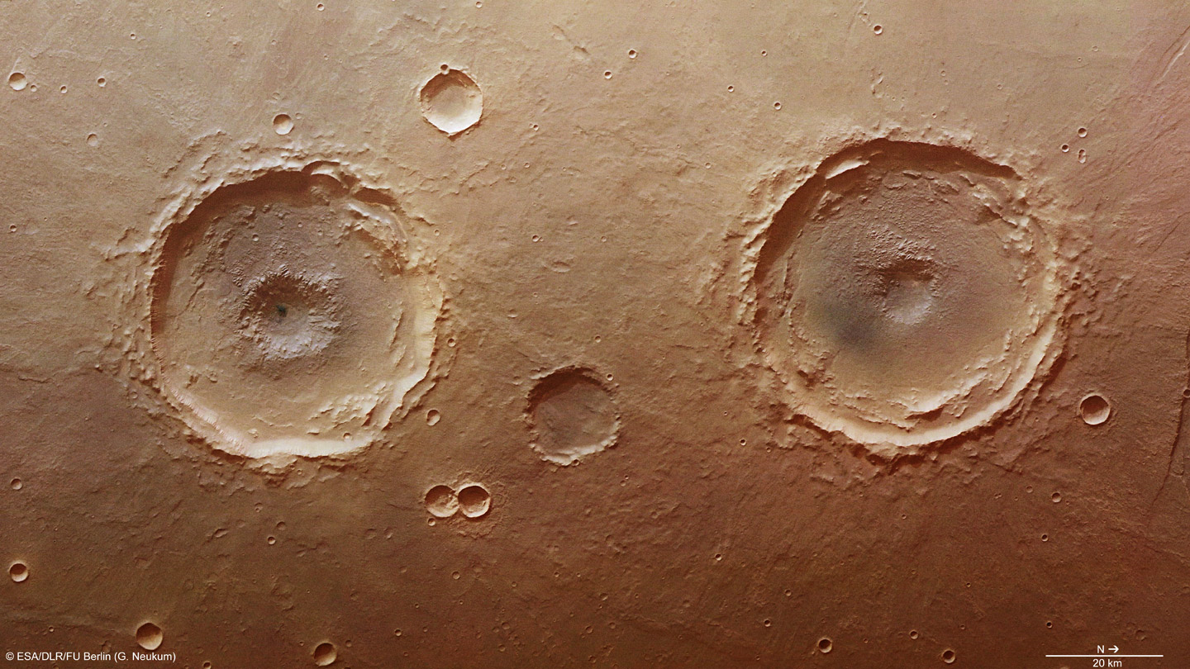
Q&A

